Slide 1

Minor project
Image Captioning

Slide 2

MINOR PROJECT PRESENTATION
IMAGE CAPTIONING
Submitted in partial fulfillment of the requirements
for the award of the degree of
Bachelor of Technology
Computer Science and Engineering
Submitted by:
Team - 17
Guide:
Ms. Teena Verma
HMR INSTITUTE OF TECHNOLOGY & MANAGEMENT
HAMIDPUR, DELHI 110 036
Affiliated to
GURU GOBIND SINGH INDRAPRASTHA UNIVERSITY
Sector – 16C Dwarka, Delhi – 110075, India
2017-2021

Slide 3
The Team
Deepak Kumar 00796502717
Deepak Kumar Rai 00696502717
Jnaneshwar 01096502717
Manthan Singh 01396502717
Guided by:
Ms. Teena Verma
Associate Professor
(Department of Computer Science and Engineering, HMRITM)

Slide 4
Contents
Introduction
Objective
The Dataset
What is CNN?
What is RNN?
What is LSTM?
The Model
Result
Summary
Future Scope
Bibliography
Links Related to Project

Slide 5
INTRODUCTION
You saw an image and your brain can easily tell what the image is about, but can a computer tell what the image is representing? Computer vision researchers worked on this a lot and they considered it impossible until now! With the advancement in Deep learning techniques, availability of huge datasets and computer power, we can build models that can generate captions for an image.
This is what we are going to implement in this Python based project where we will use deep learning techniques of Convolutional Neural Networks and a type of Recurrent Neural Network (LSTM) together.

Slide 6
WHAT IS IMAGE CAPTION GENERATOR
Image caption generator is a task that involves computer vision and natural language processing concepts to recognize the context of an image and describe them in a natural language like English.

Slide 7
OBJECTIVE
The objective of our project is to learn the concepts of a CNN and LSTM model and build a working model of Image caption generator by implementing CNN with LSTM.
In this Python project, we will be implementing the caption generator using CNN (Convolutional Neural Networks) and LSTM (Long short term memory). The image features will be extracted from Xception which is a CNN model trained on the imagenet dataset and then we feed the features into the LSTM model which will be responsible for generating the image captions.

Slide 8
THE DATASET
For the image caption generator, we will be using the Flickr_8K dataset. There are also other big datasets like Flickr_30K and MSCOCO dataset but it can take weeks just to train the network so we will be using a small Flickr8k dataset. The advantage of a huge dataset is that we can build better models.
Thanks to Jason Brownlee for providing a direct link to download the dataset (Size: 1GB).
Flicker8k_Dataset
Flickr_8k_text
The Flickr_8k_text folder contains file Flickr8k.token which is the main file of our dataset that contains image name and their respective captions separated by newline(“\n”).

Slide 9
WHAT IS CNN?
Convolutional Neural networks are specialized deep neural networks which can process the data that has input shape like a 2D matrix. Images are easily represented as a 2D matrix and CNN is very useful in working with images.
CNN is basically used for image classifications and identifying if an image is a bird, a plane or Superman, etc.
It scans images from left to right and top to bottom to pull out important features from the image and combines the feature to classify images. It can handle the images that have been translated, rotated, scaled and changes in perspective.

Slide 10
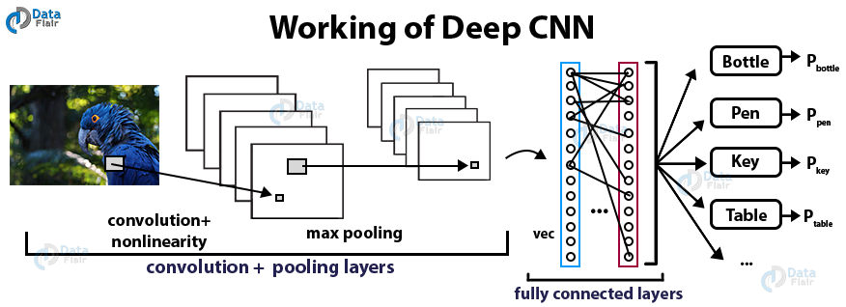
ARCHITECTURE OF CNN

Slide 11
What is RNN?
Recurrent Neural Network is a generalization of feedforward neural network that has an internal memory. RNN is recurrent in nature as it performs the same function for every input of data while the output of the current input depends on the past one computation. After producing the output, it is copied and sent back into the recurrent network. For making a decision, it considers the current input and the output that it has learned from the previous input.

Slide 12
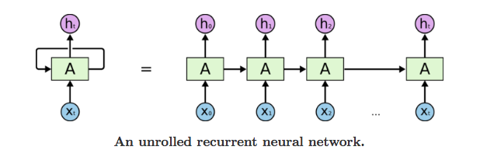
ARCHITECTURE OF RNN

Slide 13
WHAT IS LSTM?
LSTM stands for Long short term memory, they are a type of RNN (recurrent neural network) which is well suited for sequence prediction problems. Based on the previous text, we can predict what the next word will be. It has proven itself effective from the traditional RNN by overcoming the limitations of RNN which had short term memory. LSTM can carry out relevant information throughout the processing of inputs and with a forget gate, it discards non-relevant information.

Slide 14
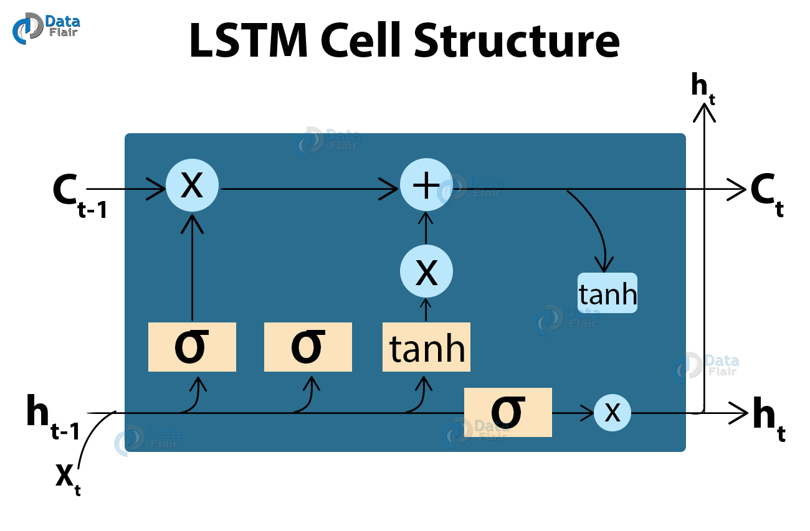
ARCHITECTURE OF LSTM

Slide 15
IMAGE CAPTION GENERATOR MODEL
So, to make our image caption generator model, we will be merging these architectures. It is also called a CNN-RNN model.
CNN is used for extracting features from the image. We will use the pre-trained model Xception.
LSTM will use the information from CNN to help generate a description of the image.

Slide 16
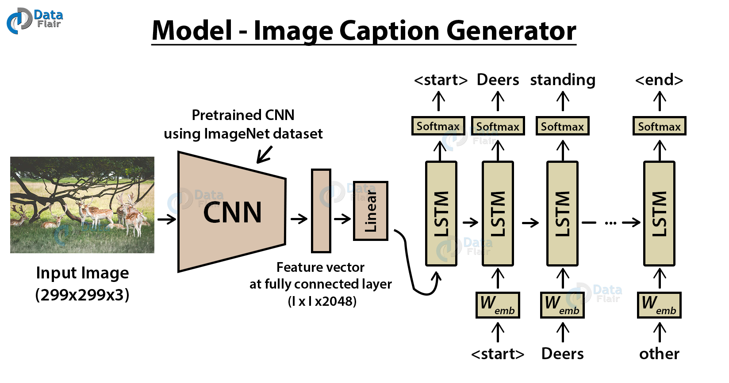
THE MODEL

Slide 17
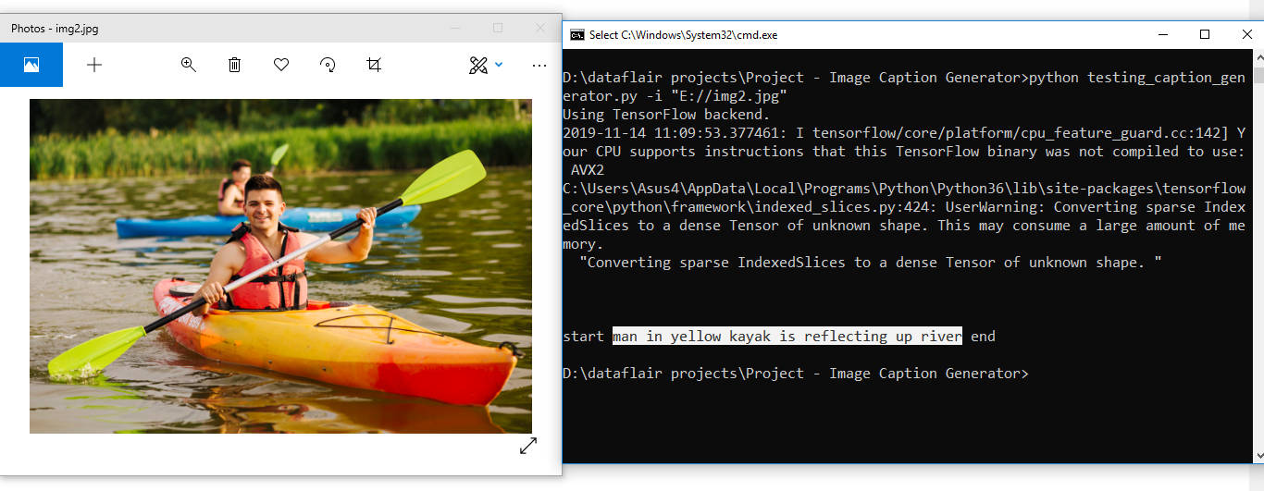
RESULT

Slide 18
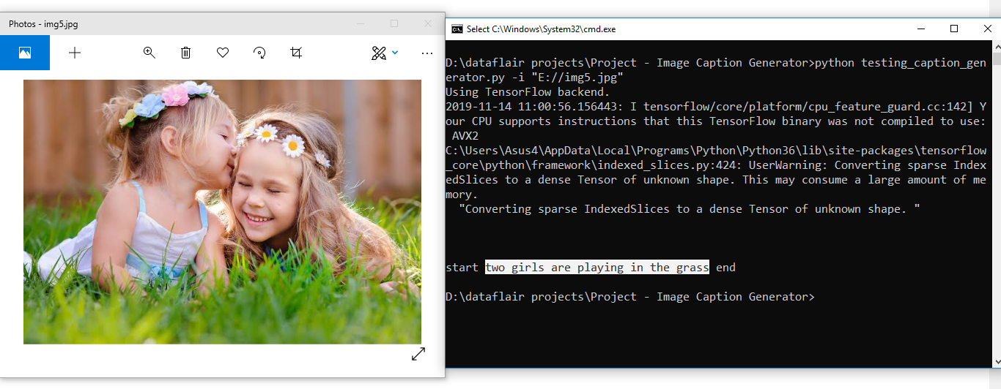
MORE RESULTS

Slide 19
SUMMARY
In this project, we have implemented a CNN-RNN model by building an image caption generator. Some key points to note are that our model depends on the data, so, it cannot predict the words that are out of its vocabulary. We used a small dataset consisting of 8000 images. For production-level models, we need to train on datasets larger than 100,000 images which can produce better accuracy models.

Slide 20
Future Scope
Image Captioning Models can be used at various areas in real life problems like:
Vehicle Automation
Robotics
Medical Sciences
Aerospace Engineering

Slide 21
CONS OF THIS MODEL
1. Accuracy , definitely the major concern . It lacks a higher accuracy level.
2. Currently this model requires a lot of processing power. Training this on CPU is not convenient, it requires GPU due to a lot of training Images and Text data.
3. Time Consuming. It takes almost 2 hours on simple GPU to train.

Slide 22
Project Links
GitHub : https://github.com/imdeepak27/Minor-Project-2020-21
Kaggle : https://www.kaggle.com/daepak/automated-image-captioning-flickr8k-dataset/edit/run/42331107
Flickr 8k Dataset :
https://github.com/jbrownlee/Datasets/releases/download/Flickr8k/Flickr8k_Dataset.zip
https://github.com/jbrownlee/Datasets/releases/download/Flickr8k/Flickr8k_text.zip

Slide 23
BIBLIOGRAPHY
https://arxiv.org/pdf/1810.04020.pdf
https://papers.nips.cc/paper/9293-image-captioning-transforming-objects-into-words.pdf
https://data-flair.training/blogs/python-based-project-image-caption-generator-cnn/
https://machinelearningmastery.com/prepare-photo-caption-dataset-training-deep-learning-model/
https://ieeexplore.ieee.org/document/8308186
https://arxiv.org/abs/1808.03314

Slide 24
THANK YOU

